Slide 1

QBC Sponsorship Program

Slide 2
Reason
Establish ground rules for standardization
  Fairness to Sponsors
  How long sponsorships last
    1,2,3,4,5 - years
    Recommend 4 years (based on the life of a Jersey)
  Sponsor dollars
    20% - Charity fund
    XX amount to digitize their logo
    Rest goes to general fund
  Sponsors will sponsor QBC, not individuals
      Uniform Jerseys
      Or, a standard set amount of QBC logos

Slide 3
Different levels of Sponsorship
  Tier 1 - Gold
    Pays XXX (TBD-$250)
    Gets Spot on the Jersey
    Added to QBC website with links/contact info
  Tier 2 - Silver
    Pays XX(TBD-$100)
    Added to QBC website with links/contact info
  Tier 3 - Bronze
    Supports QBC or QBC supports them
    Added to QBC website with links/contact info

Slide 4
Potential Sponsors
Bass Pro Shops
Boerne Marine
Du Mor Enterprises
Mike’s BBQ
Falcon Lake Tackle
Pure Fishing
NCOA
Sure Life
Cathy’s travel Agency
Irene’s Antiques
Fischer House
My House Lounge
Others ????

Slide 5
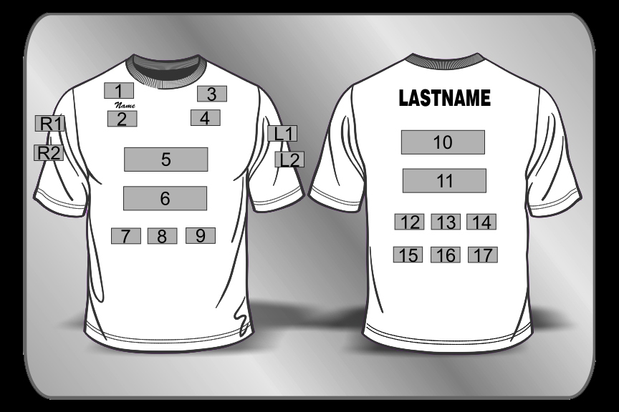
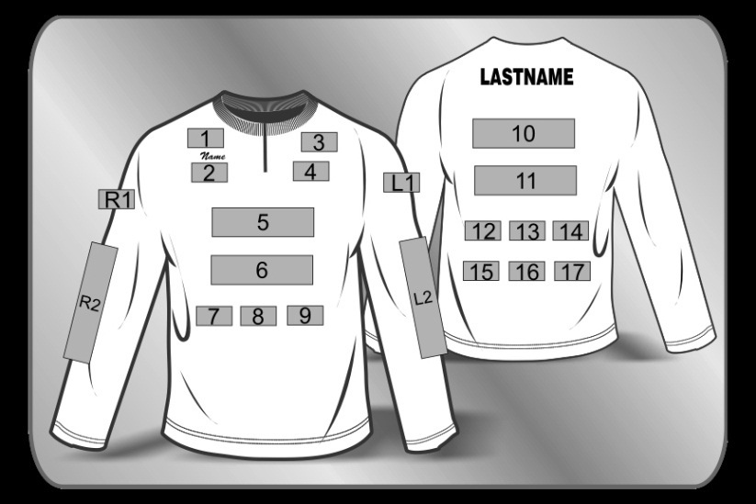
Jersey Design

Slide 6
Jersey Vendors
RayJus Outdoors
Atomic Fishing Jerseys
e3sports
MyLocker

